Slide 1

PowerPoint Party
Theme

Slide 2
Introduction
Get festive with your friends, family, or co-workers with a PowerPoint party. The idea of a PowerPoint party to have everyone create and lead presentations based on the topic of their choice.
Tips for creating your own PowerPoint party:
Choose a theme or idea: Are you super passionate about a TV show? Do you want to teach the group a new skill? Your presentation can be about anything you want. The goal is to be light-hearted, playful, and funny.
Create your slides: Get creative! Feel free to experiment with text, pictures, animations, or anything you can find to tell your story.
Present your PowerPoint: Show off your skills. Make it interactive. And remember to have fun.

Slide 3
Choose a theme
Your theme can be anything you want. Here are some examples to start:
Explain why [subject] is your favorite movie.
Teach about a famous person in history.
Introduce the group to your hidden talent.

Slide 4
Add a funny Quote
“QUOTES…

Slide 5

about Your theme
You can write about your theme here.
You can explain why you chose the theme.
The goal is to be light-hearted, playful, and funny

Slide 6

Add Pictures
Picture #1
Picture #2
Picture #3

Slide 7
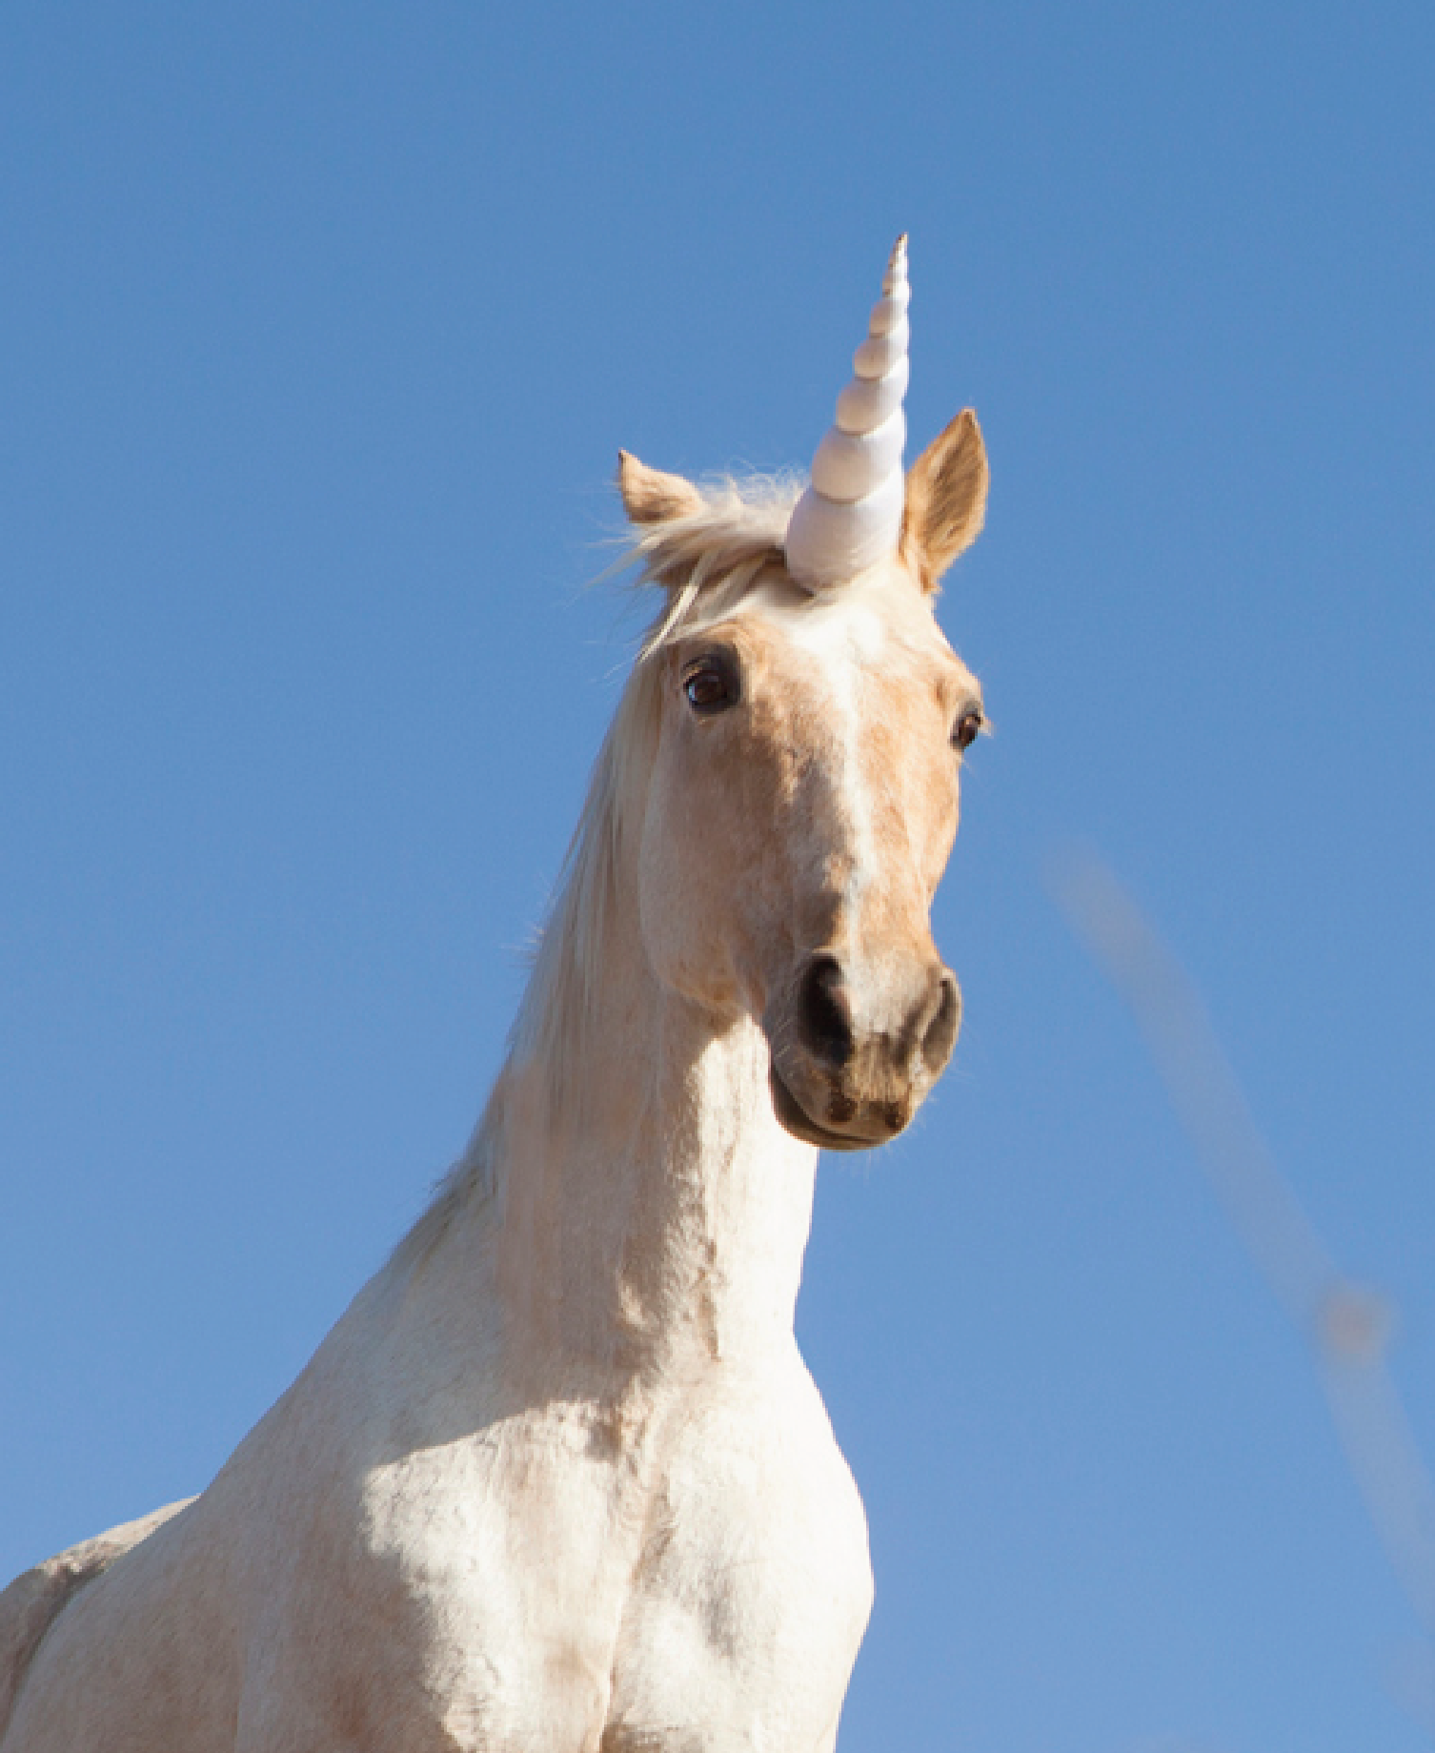
THEME INFO
You can write about your theme here.
You can explain why you chose the theme.
The goal is to be light-hearted, playful, and funny

Slide 8
Add Video

Slide 9
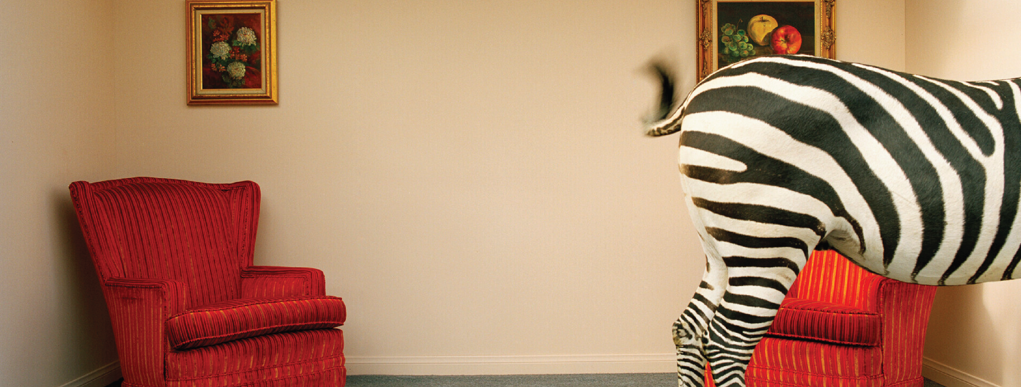
Questions?
Subtitle goes here

